Slide 1
Operational Integration and Operations on AWS

Slide 2
Notes to Presenter
You should use this presentation to introduce OI to customers as a kickoff presentation for the operations workstream during a migration
You should invite all the people that may be involved from the customer side as well as project stakeholders such as sponsors
You should ask for feedback and take note of questions asked during the presentation
You should solicit open ended input from the customer regarding their questions about operating on AWS and operations on AWS so you can align this presentation appropriately
This presentation is a superset of organized content for introducing Operational integration with AWS and Operations on AWS
You should hide the slides to align with your allocated time and scope
When presenting AWS services covered in this presentation, provide the operations perspective and use case for the service and relate it back to existing tools / services the customer may be using
You should record the session and send to the customer as well as make it available on any documentation that you provide as a part of your delivery
Please provide feedback on your delivery and contribute back with additional content that you added that was helpful.
<Feedback Link>

Slide 3
Disclaimers
The following applies to this document and all other documents, information, data, and responses (written or verbal) provided by Amazon Web Services, Inc. or any of its affiliates (collectively, "AWS") in connection with responding to this request and other related requests (collectively, this "Response"): This Response is expressly (a) informational only and provided solely for discussion purposes, (b) non-binding and not an offer to contract that can be accepted by any party, (c) provided "as is" with no representations or warranties whatsoever, and (d) based on AWS's current knowledge and may change at any time due to a variety of factors such as changes to your requirements or changes to AWS's service offerings. All obligations must be set forth in a separate, definitive written agreement between the parties. Neither party will have any liability for any failure or refusal to enter into a definitive agreement. All use of AWS's service offerings will be governed by the AWS Customer Agreement available at http://aws.amazon.com/agreement/ (or other definitive written agreement between the parties governing the use of AWS's service offerings) (as applicable, the "Agreement"). If the parties have an applicable Nondisclosure Agreement ("NDA"), then the NDA will apply to all Confidential Information (as defined in the NDA) disclosed in connection with this Response. AWS's pricing is publicly available and subject to change in accordance with the Agreement. Pricing information (if any) provided in this Response is only an estimate and is expressly not a binding quote. Fees and charges will be based on actual usage of AWS services, which may vary from the estimates provided. Nothing in this Response will modify or supplement the terms of the Agreement or the NDA. No part of this Response may be disclosed without AWS's prior written consent.

Slide 4
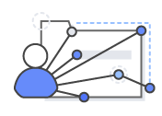
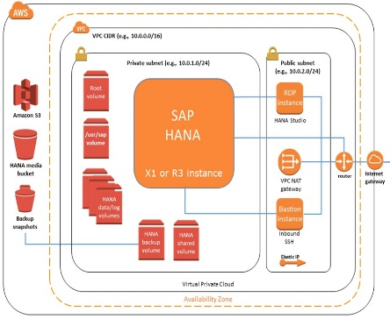

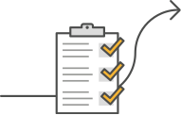

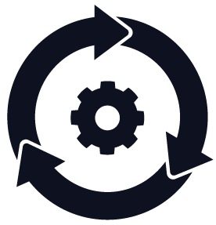


Mobilize Outcomes
Discovery & Planning
AWS Landing Zone
Skills/Center of Excellence
Migration Business Case
Security & Compliance
Operating Model & Tools
Migration Expertise
Migration Plan
Notes:
The Mobilize phase allows you to address gaps in your operational readiness and migration planning.
The first four focus on Operational readiness:
Landing Zone: designs and deploys the environment in AWS, including the Account structure, Network design that considers VPC, VPN, Direct Connection and multi-region, controlled Identity and Access Management, and service catalogue definition to achieve your functionality and user experience needs.
Cloud Center of Excellence defining, training and building experience in your teams.
Cloud Operations Model: determines the structure, planning and operations practices for you to maximize business benefits
Security and Compliance: assess and close gaps, and implement the security and compliance practices and monitoring systems
In parallel, Portfolio Discovery and Migration: application assessment, identification of common patterns and then sequencing and planning of your migrations.
Finally, business case development for the communication and to obtain internal approval for your migration.
During this phase, the teams will perform initial migrations to build experience and confidence through quick wins.
[ DETAILS]: The Mobilize phase brings the tools, expertise and migration resources together to accelerate your selected migration workloads, including
Landing Zone (Account structure, Network design including VPC, VPN, DX, & multi-region , Identity Access Management)
Skills/Center of Excellence (Cloud expertise across IT, Security and Business, key roles, training, tooling
Discovery & Planning (Defining Application Patterns and Grouping, Application Design Process, Initial backlog of applications ready to migrate)
Migration Business Case (TCO Modelling, Business Value Assessment, Options to Optimize)
Security & Compliance (Governance, risk, and compliance models, Preventive measures to protect & mitigate threats, Security Responses playbook)
Operating Model (Operational Run Books for: Monitoring, Logging, Provisioning, Asset Management, and Configuration Management, Business Continuity Planning and Disaster Recovery)
Migration Experience (Start Migrations Day 1, Migrate a series of Application Patterns
Migration Plan (Project Plans, Cost Estimate, Communication Plans, Change Management

Slide 5

What is Operational Integration (OI)?
Covers the operations domains customers need to manage and control their environments
Includes IT Service Management (ITSM) best practices, Core Operations, Security & Control, Business Management and Supporting Functions

Slide 6
Related AWS Frameworks
The Well-Architected Framework has been developed to help cloud architects build the most secure, high-performing, resilient, and efficient infrastructure possible for their applications.
Pillars of the WAF
Operational Excellence
Security
Reliability
Performance Efficiency
Cost Optimization
Sustainability
https://aws.amazon.com/architecture/well-architected/
The Cloud Adoption Framework The AWS Cloud Adoption Framework helps organizations understand how cloud adoption transforms the way they work, and it provides structure to identify and address gaps in skills and processes.
Perspectives of the CAF
Business
People
Governance
Platform
Security
Operations
https://aws.amazon.com/professional-services/CAF/

Slide 7




Operations Integration – Business Outcomes
A planned cloud adoption approach looks like this:
Future
Value
Scale
Development in a lab-environment: Project
Launch
Traditional Operations
Deployment in a non-production mode:
Foundation
Foundation
THE GREAT STALL
Project
Time
Go-Live to a restricted audience or geography:
Launch
Expansion of deployment, user-base or features:
Scale
Traditional operations do not scale to support mass-cloud adoption. Value fails to increase.
Notes:
Planned Approach is key – most people familiar with this, it’s a logical step that appears to work.
However, in a cloud programme this is not always the way – the traditional operations bit comes in and the great stall happens

Slide 8




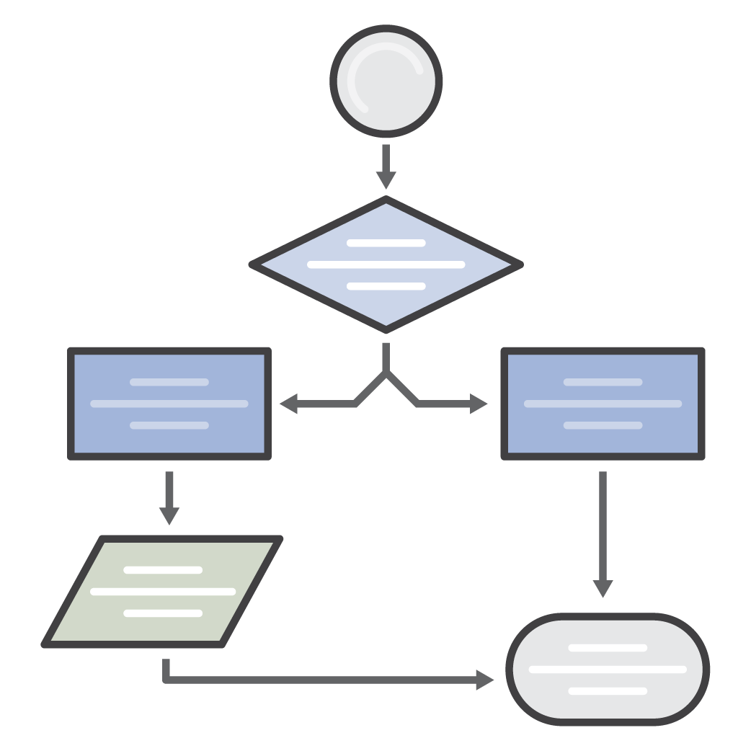



Why, and when, do I need a Cloud Operating Model?
Customers need a COM to:
When any of the following required:
Meet consumer requirements Perform value chain mapping
Perform End-to-End Service Design
Assign Accountability
‘Production’ workload support
Regulatory Compliance
Formal support relationship
Migration of on-prem applications
Notes:
What is the Cloud Operating Model?
Describes the relationship between the consumers and suppliers of Cloud Services within an Enterprise
The value a customer obtains from AWS is directly linked to the effectiveness of the COM
The primary purpose of the COM is to meet the needs of the consumers
COM is expected to change with time

Slide 9











What is an Operating Model?
An Operating Model defines how the Business and IT align and operate to reach strategic business objectives.
Business
Operating Model
IT
Operating Model
Outcomes
Outcomes
New Ideas &
Innovation
Business
Objectives
Technology
Capabilities
Operational
Excellence
Speed &
Agility
Digital
Products
& Services
Cost
Optimization
Business
Processes
Technology
Processes
Value &
Results
Business
Workforce
Technology
Workforce
Security &
Compliance

Slide 10
How do we define an Operating Model?
Using a simple 2x2 matrix, we can illustrate who is responsible for different pieces of the IT lifecycle
Engineering
Operations
Business Software
Custom Developed or
Common of the Shelf
Develop, Build, and Test
All activities needed to define and validate Platform Infrastructure or Business Applications
Applications
ITSM
Platform Infrastructure
Compute | Network | Storage
Middleware | Runtime | Data
Operations | Security
Deploy, Operate, and Manage
All activities needed to deploy and support platform infrastructure and applications in production
Platform
Notes:
Sustain / Traditional
Development Teams develop, build, and package software for release by operations
Cloud Engineering may or may not be present to codify infrastructure standards and artifacts for release by operations
Operations May leverage either CCOE products and services to deploy and manage applications and infrastructure in production
Operations may be a 3rd party MSP, or an existing on-prem operations team.
Optimize / CloudOps
Development Teams develop, build, and package software for release by operations
Cloud Engineering codifies infrastructure standards and artifacts; provides enabling services for operations and security.
Cloud Operations: provisions and configures infrastructure from standard CCOE products and services; leverages CCOE products and services to manage applications and infrastructure in production
Grow / DevOps
Development Teams leverage CCOE products and services to:
Develop, build, and package software for release
Provision and configure infrastructure from standard CCOE products and services
Leverages CCOE products and services to deploy and manage applications and infrastructure in production
Cloud Engineering codifies infrastructure standards and artifacts; provides enabling services for operations and security.

Slide 11

What Operating Models do we recommend?
Sustain
“Traditional Ops”
Optimize
“CloudOps”
Grow
“DevOps”
Engineering
Operations
Engineering
Operations
Engineering
Operations
Dev Team /
COTS
Cloud Operations
Dev Team /
COTS
DevOps
Teams
App
Ops
Applications
DevOps
Applications
DevOps
Applications
DevOps
ITSM
ITSM
ITSM
Cloud Platform Engineering
Cloud
Platform
Engineering
Platform
Ops
Platform
Platform
Platform
Cloud Platform Engineering
Transitional
Strategic
Strategic
Notes:
Each line represents a division in responsibility and where those divisions occur, we see ‘friction’ between the organizational groups.
Sustain / Traditional (Key teams are siloed)
Development Teams develop, build, and package software for release by operations
Cloud Engineering may or may not be present to codify infrastructure standards and artifacts for release by operations
Operations May leverage either CCOE products and services to deploy and manage applications and infrastructure in production
Operations may be a 3rd party MSP, or an existing on-prem operations team.
Optimize / CloudOps (Key balanced shared responsibilities)
Development Teams develop, build, and package software for release by operations
Cloud Engineering codifies infrastructure standards and artifacts; provides enabling services for operations and security.
Cloud Operations: provisions and configures infrastructure from standard CCOE products and services; leverages CCOE products and services to manage applications and infrastructure in production
Grow / DevOps (you build it you own it)
Development Teams leverage CCOE products and services to:
Develop, build, and package software for release
Provision and configure infrastructure from standard CCOE products and services
Leverages CCOE products and services to deploy and manage applications and infrastructure in production
Cloud Engineering codifies infrastructure standards and artifacts; provides enabling services for operations and security.

Slide 12
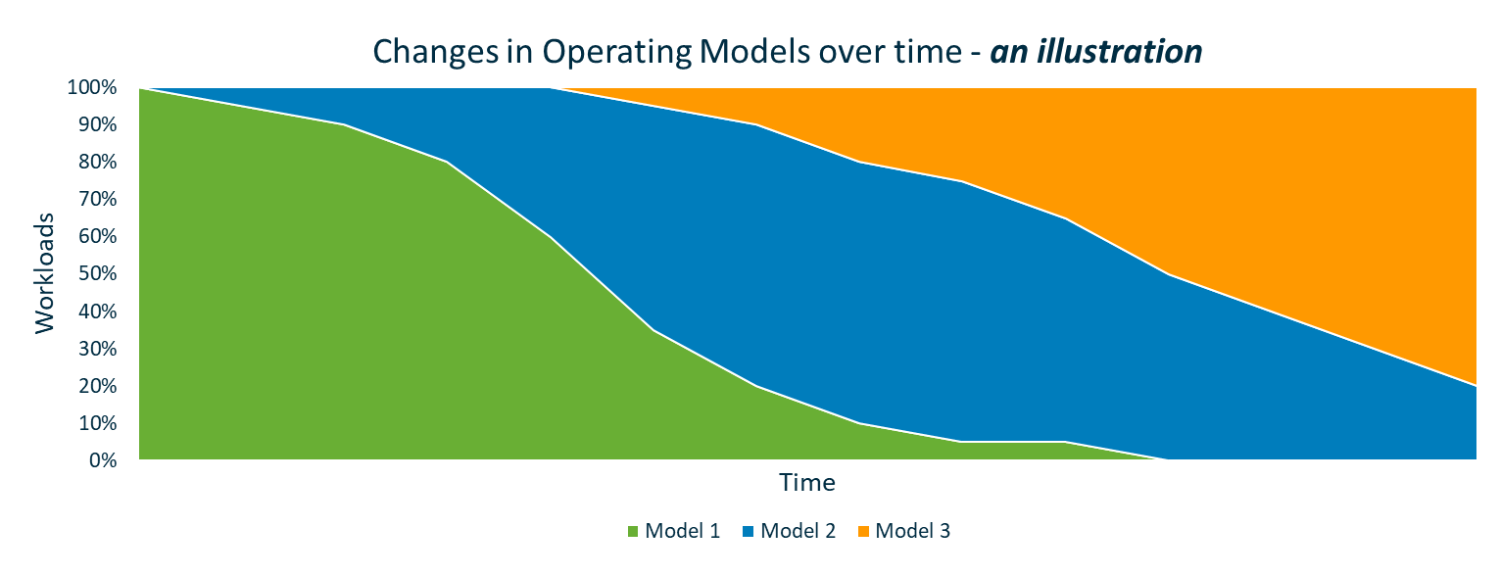
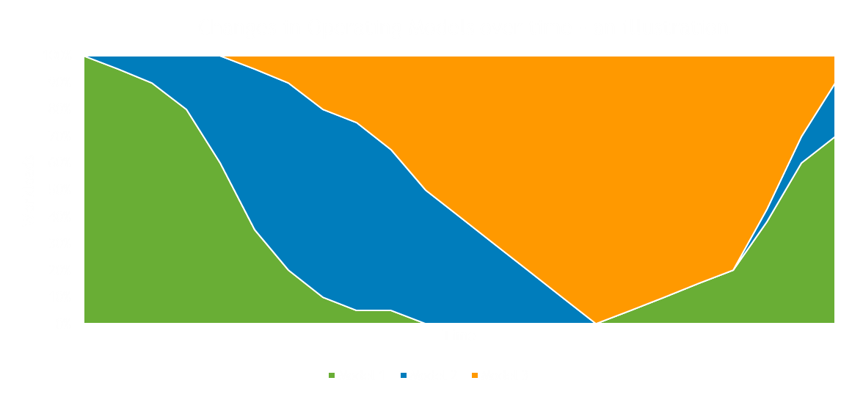
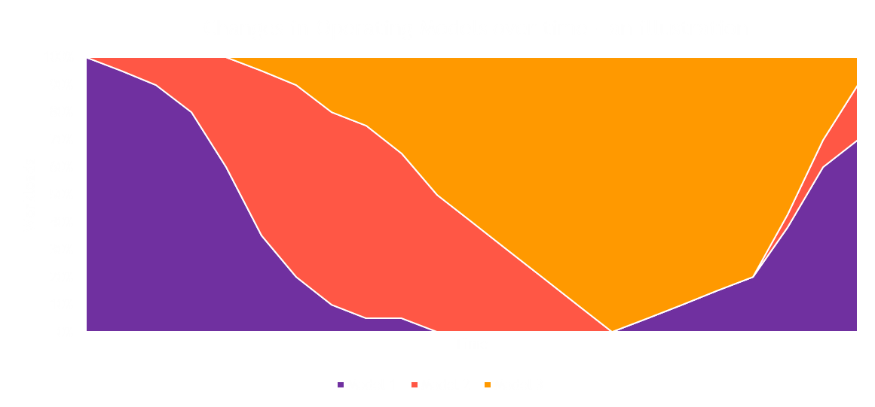
The mix of models changes over time
Model 1: Current way of working
Model 2: Interim step, could be experimental, or part of desired state
Model 3: The desired, or more advanced state. Don’t try and go there straight away…
Each start small
Could be that multiple models are always required, that’s OK
Be prepared to keep iterating
Success means looking at the details of each model – OI has that best practice available

Slide 13
Models that enable both App & Platform to be delivered as products
Optimize
“CloudOps”
Grow
“DevOps”
Engineering
Operations
Engineering
Operations
Dev Team /
COTS
DevOps
Teams
Applications
DevOps
Applications
DevOps
ITSM
ITSM
Cloud Platform Engineering
Platform
Platform
Cloud Platform Engineering
Strategic
Strategic
Notes:
Sustain / Traditional
Development Teams develop, build, and package software for release by operations
Cloud Engineering may or may not be present to codify infrastructure standards and artifacts for release by operations
Operations May leverage either CCOE products and services to deploy and manage applications and infrastructure in production
Operations may be a 3rd party MSP, or an existing on-prem operations team.
Optimize / CloudOps
Development Teams develop, build, and package software for release by operations
Cloud Engineering codifies infrastructure standards and artifacts; provides enabling services for operations and security.
Cloud Operations: provisions and configures infrastructure from standard CCOE products and services; leverages CCOE products and services to manage applications and infrastructure in production
Grow / DevOps
Development Teams leverage CCOE products and services to:
Develop, build, and package software for release
Provision and configure infrastructure from standard CCOE products and services
Leverages CCOE products and services to deploy and manage applications and infrastructure in production
Cloud Engineering codifies infrastructure standards and artifacts; provides enabling services for operations and security.

Slide 14

How does my Operating Model affect my migration path to AWS?
Migration paths should be chosen to support desired business outcomes,
not to speed up migration.
Engineering
Operations
Dev Team /
COTS
Cloud Operations
App
Ops
Applications
DevOps
Traditional
Ops
ITSM
Sustain
Rehost
Cloud
Platform
Engineering
Platform
Ops
Platform
Engineering
Operations
Dev Team /
COTS
Applications
DevOps
Replatform
ITSM
Cloud
Ops
Optimize
Cloud Platform Engineering
Determine
Platform
Discover
Repurchase
Engineering
Operations
DevOps
Teams
Retain
Applications
DevOps
Refactor
ITSM
DevOps
Grow
Retire
Platform
Lift
& Shift
Lift
& Reshape
Drop
& Shop
Rearchitect
Cloud Platform Engineering

Slide 15



Cloud Operating Model Target Operating Model Perspectives
PEOPLE
PROCESS
TOOLS

Slide 16

Cloud Operating Model - People
Consumers
Business
Product Owners
End Users
Compliance, Security, Finance
Service Providers
Application/Infrastructure Developers
Operations
Shared Services
Dependent Services
Align people/CCOE
People

Slide 17
Cloud Operating Model - Process
Cycle 1: Prioritize core
Core Operations Functions
Security & Control Functions
Business Management Functions
Supporting Functions
Platform Architecture & Governance
Change Management
Financial Management
Reporting & Analytics
Operational Health
Resource Inventory Management
Capacity Planning & Forecasting
Continuous Improvement
PROCESS
Provisioning & Configuration Management
Identity & Access Management
Organisational Change Management
Application Lifecycle Management
Availability & Continuity Management
Security Management
Vendor Management

Slide 18
Cloud Operating Model – Process Application Lifecycle Framework
Change
Design
Operations
Applications
Code, Configuration, App Architecture
Application deployment, monitoring, support
ITSM
Service Workflow
Catalog
Service Config, Infra Architecture, Artefacts
Service Provisioning, Patching, Monitoring, Support
Infrastructure
Orchestration

Slide 19
Core Operations Functions
Functions
Capabilities and Considerations
Platform Architecture & Governance
Account Strategy, VPC Strategy, Multi-Region/Multi-AZ Strategy, Tagging Strategy, IP Addressing and Connectivity, Security Strategy, Audit and Compliance
Operational Health
Monitoring, Cloud Metrics, Logging, Analytics, Cloud Runbooks, Alerting/Alarming, Incident Management Process, AWS Support Engagement, Service Desk, Toolsets/integrations
Provisioning & Configuration Management
Provisioning, CICD Pipeline and Toolset, Release Management, Testing Framework and Toolset, Code Repository, Branching Strategy, Blue/Green Deployments, CMDB, Configuration Items
Availability & Continuity Management
High Availability Architecture, Auto-Scaling, Backup and Restore, Replication, RTO/RPO, Data Storage and Retention Policy, Disaster Recovery, Automation and Bots, Hybrid Options – Storage Gateways

Slide 20
Cloud Operating Model - Tools
Integration points with Non-AWS
AWS Management & Governance
(CloudFormation, Systems Manager, CloudWatch, Service Catalog, Config,
CloudTrail, OpsWorks, AMS)
ITSM/Cloud Management Tools
(ServiceNow, HP, BMC Remedy, Cherwell, Atlassian Jira Service Desk)
Monitoring Tools
(Splunk, DataDog, AppDynamics)
Security Tools
(Nexxus, Trip Wire)
Tools

Slide 21
Cloud Operation Tools Assessment
Area | Cycle 1 Focus/Tools | Customer X (yes/no) | Long Term Tools
Platform Architecture & Governance | Governance, Guardrails, Enterprise Architecture and Platform Design for AWS, Tagging, Systems Manager |  | Iteration
Event & Incident Management | Logging & Monitoring, Service Restoration, CloudWatch, SNS |  | Integration with ITSM (SN, BMC..)
Provisioning & Configuration Management | Template Consumption, Infrastructure as Code, Service Catalog, CloudFormation |  | Integration with ITSM (SN, BMC..)
Availability & Continuity Management | Reliability, Serviceability, Resiliency, AZs Fail-over, Volume Backup, SLA for Cloud |  | Regions Fail-over, BCP
IT Change Management | Compliance & Controls, Risk Management, Service Catalog, Config, CloudTrail |  | Integration with ITSM (SN, BMC..)
Resource Inventory Management | Transparency, Resource Lifecycle, Config, EKK |  | Integration with ITSM (SN, BMC..)
Identity & Access Management | Least Privilege, IAM, Federation, MASCOT (multi-account) |  | IAM, Federation, AWS Organizations
Security Management | Security Controls, Security Incident Response, Specified by Security Stream |  | Managed by Security Stream
Financial Management | Tagging, Billing Report, Cost Optimization (Right sizing, Governance), Trusted Advisor |  | Integration with ITSM (SN, BMC..)
Capacity Planning & Forecasting | “Fit for Purpose Designs”, Resource Trends, Config, Trust Advisor, Budget |  | ITSM (SN, BMC..), Discovery
Organizational Change Management | Training, Communications, Transformational Buy-In |  | Cloud Center of Excellence -> Cloud Advisory
Vendor Management | Outsourced Provider Controls, Managed by Procurement Team |  | Managed by Procurement Team
Reporting & Analytics | Usage Trends, Service Health, EKK, QuickSight |  | Log Analysis tooling (Splunk, Datadog, Sumo)
Continuous Improvement | Process Iterations, Trusted Advisor, EKK, QuickSight |  | Cloud Business Office
Application Lifecycle Management | SDLC, People/Process/Tools Integrations, DevOps Stream |  | Managed by DevOps

Slide 22
Operational Integration Domains

Slide 23
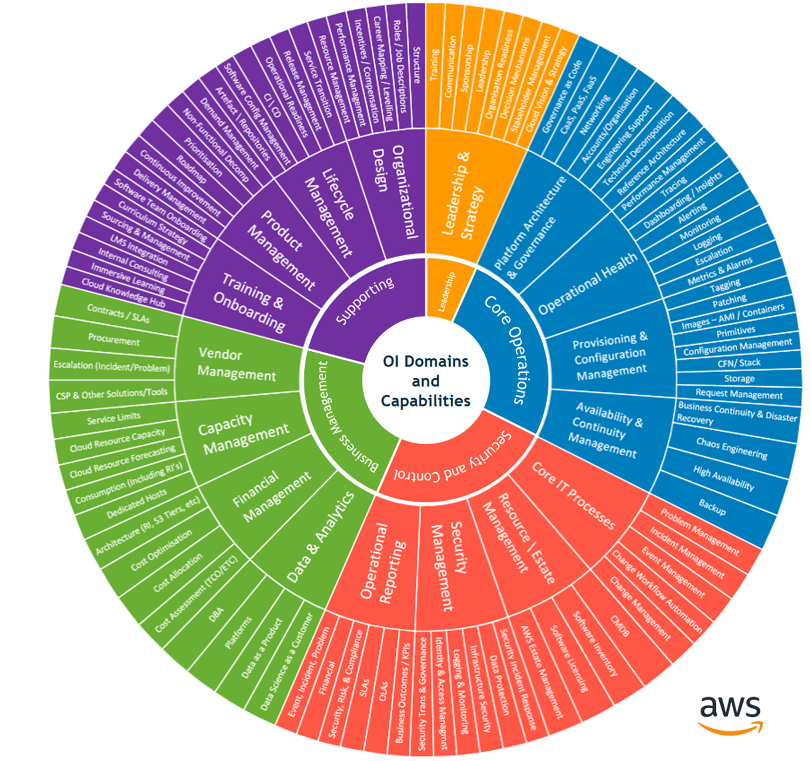
98 Capabilities
OI Domains are groups of capabilities that are required in any Cloud Operating Model
It is likely that a team will have a mixture of maturity levels for each of these capabilities.
We focus on the core operational capability for migrations
Notes:
5 Perspectives, 17 Domains, 98 Capabilities. This is the real meat of the OI work. It represents our best practice and all the capabilities we help to build with customers. a lot of these you probably know already or will have operations people familiar with them. But we help put that in to the new cloud context.
Finally, this is a big list and you don’t have to do all these at once, it might take years to get there and that’s OK. It is a marathon not a sprint. But basically this is where we help. We have expertise available in these areas, but the key is what you need and what the priority is – back to ensuring we understand the Business Outcomes we only want to help with what you need to get going, improve specific areas, or set you up for the future.

Slide 24
AWS Operational Domains
Core Operations Functions
Security & Control Functions
Business Management Functions
Supporting Functions
Platform Architecture & Governance
IT Change Management
Financial Management
Reporting & Analytics
Operational Health
Resource Inventory Management
Capacity Planning & Forecasting
Continuous Improvement
Provisioning & Configuration Management
Identity & Access Management
Organizational Change Management
Application Lifecycle Management
Availability & Continuity Management
Security Management
Vendor Management

Slide 25
What does good for Operations? → Powerful Tenets and Mindset!
Iterative Release Cycle
‘You Build it, You Own it’ / ’You Own it, You Build it’
Management by exception
Test Driven Development
Pets vs. Cattle
‘Build Once, Use Many’
Tools are fit for purpose
Operations capability roadmaps and development must be driven by customer demand, and be able to be changed continuously
Use a discrete services model, and each service team should have complete control over design, build, test and operate
Operations should be based on managing exceptions from expected behaviour
The entire service, including operations functions, should be testable using automation
Cloud workloads should be short-lived, disposable, stateless. Operations must support and promote these workloads
Service artifacts should be created once and then reused as widely as possible. This is only possible with a discrete service model
Use the tools which are the best for the desired result.
Notes:
What makes different Cloud Operations from Traditional Operations?
The AWS Tenets

Slide 26
AWS Operational Domains
Core Operations Functions
Security & Control Functions
Business Management Functions
Supporting Functions
Platform Architecture & Governance
IT Change Management
Financial Management
Reporting & Analytics
Operational Health
Resource Inventory Management
Capacity Planning & Forecasting
Continuous Improvement
Provisioning & Configuration Management
Identity & Access Management
Organizational Change Management
Application Lifecycle Management
Availability & Continuity Management
Security Management
Vendor Management

Slide 27
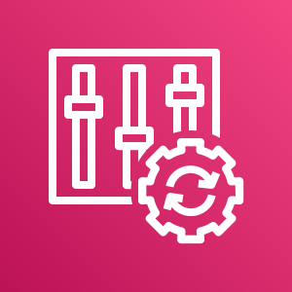

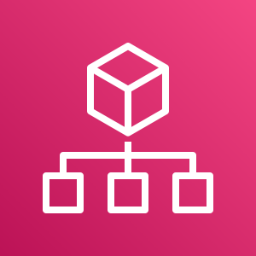
OI Domains – Core Operations Functions: Platform Architecture & Governance
Tools, Templates and Best Practices
Synopsis Defines a blueprint for the development of the technological landscape, taking into account the service strategy and newly available technologies. Governance captures the process and service performance requirements that are important to achieve strategically for the organization and map to the desired outcomes.
AWS Config
AWS Control Tower
AWS Organizations
Establish CCOE if it does not exist
Define RACI for governance of interactions between the CCOE and implementation and operational teams
Tagging and Taxonomy Standards: Resource, Chargeback/Billing, Project/Business Unit
Align compliance, security and/or regulatory standards required for Production Ready environments
Account and VPC Standards
Data Governance and Handling Standards
Evaluate Technology and Tooling Standards: Application, Deployment, Monitoring, AWS Services, SSO, Directory, Discovery, Shared Services, Security Tools and standards
High Availability, Disaster Recovery Standards
Why is the OI Function Important?
Establishes a defined mechanism for modifying the standards as the platform evolves
Creates a consensus within the organization that standards will be used
Sets the tone for cloud adoption within an organization
Notes:
The OI Domain slide in this presentation contain a detail overview of each OI domain structured with:
Synopsis – Summarizes how this domain applies to cloud OI
Why is the OI Function Important – Provides value statements for this OI function related to cloud
Tools, Templates and Best Practices – Identifies tools, templates and best practice recommendations for this OI domain. Examples of best practices could be ITSM process integrations to account for, resources that need to be included and/or key artifacts that are essential for the particular domain.
Note: The example displayed on slide is for the Core Operations Function - Platform Architecture & Governance

Slide 28
Platform Architecture & Governance – Key Epics
Increase automated governance through the Landing Zone
Implement Sandbox for Landing Zone
Govern at scale through Service Control Policies
Implement LZ Sandbox
Adopt continuous compliance (Manage by Exception)
Increase automation and control using a governance framework
Implement Cloud Custodian
Govern the cloud by exception extending the AWS Config Rules and enforce compliance with automated actions
Define and Implement Architecture Patterns
Design the cloud for autonomy from On-Prem
Define Network Patterns and Hybrid Network Architecture
Review first Application and Platform Reference Architectures
Define Tagging Strategy for governance
Automation, Chargeback, Security

Slide 29
AWS Operational Domains
Core Operations Functions
Security & Control Functions
Business Management Functions
Supporting Functions
Platform Architecture & Governance
IT Change Management
Financial Management
Reporting & Analytics
Operational Health
Resource Inventory Management
Capacity Planning & Forecasting
Continuous Improvement
Provisioning & Configuration Management
Identity & Access Management
Organizational Change Management
Application Lifecycle Management
Availability & Continuity Management
Security Management
Vendor Management

Slide 30


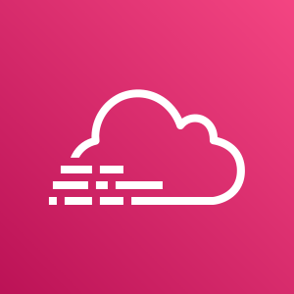
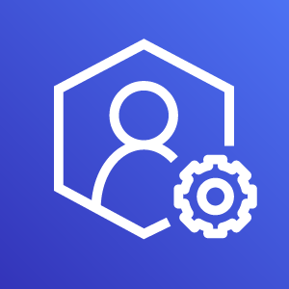


OI Domains – Core Operations Functions: Operational Health
Tools, Templates and Best Practices
Synopsis Event and Incident Management enable enterprises to control and restore cloud services. The focus of event management is to detect events, assess their potential impact, and determine the appropriate control action. Incident Management restores normal service operation as quickly as possible and minimizes the adverse impact upon business operations.
Amazon CloudWatch
AWS SNS
AWS CloudTrail
AWS Support
Amazon Elasticsearch
AWS Personal Health Dashboard
3rd Party tooling for Event & Incident Management; Integration of AWS platform with external tooling
Organization change to enable DevOps
Establish account strategy
Adapt escalation path to include AWS Support within operations procedures
Enable incident resolution and documentation
Enable knowledge management based on incident resolution
Enable a change from reactive monitoring to proactive resolutions using alerting and automation
Identify incident patterns to determine problems and corrective measures
Why is the OI Function Important?
Restoring disrupted service in a timely fashion
Self healing environments
Self documenting incident resolution

Slide 31
Operational Health – Key Epics
Define Monitoring Tool Stack & Metrics
Identify SLA requirements per solution.
Define Telemetry, Metrics and Thresholds per service
Define and implement Centralized Logging tools for Logs Analytics
Adopt and implement APM & Synthetic monitoring tools
* Mandatory for external customers
Define Incident and Event Management processes
Reinforce operations discipline through KPIs (MTTA, MTTR)
Improve visual detection through dashboards and automated alerts (Prometheus)
Automate 1st response level runbooks
Adopt and implement an Agile Ops Tool (CloudWatch Anomaly Detection, PagerDuty, VictorOps, OpsGenie, etc.)
Gain Ops sustainability
Reinforce the Ops team for On-call or Duty Shifts
Schedule shifts to achieve critical SLAs 24x7x365 (ensure your 9’s)
AWS Enterprise Support is mandatory for production workloads
Discipline is key to transition from Traditional Ops to Cloud Ops
P0 and P1 must have a Post-mortem, RCA and action plan

Slide 32
AWS Operational Domains
Core Operations Functions
Security & Control Functions
Business Management Functions
Supporting Functions
Platform Architecture & Governance
IT Change Management
Financial Management
Reporting & Analytics
Operational Health
Resource Inventory Management
Capacity Planning & Forecasting
Continuous Improvement
Provisioning & Configuration Management
Identity & Access Management
Organizational Change Management
Application Lifecycle Management
Availability & Continuity Management
Security Management
Vendor Management

Slide 33
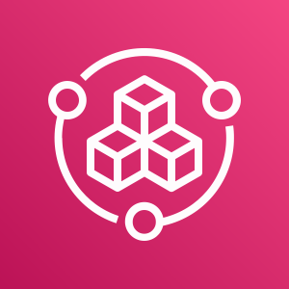
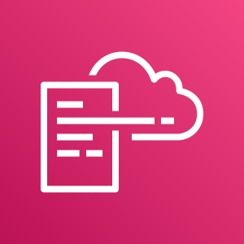
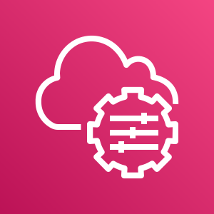
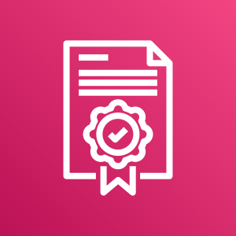
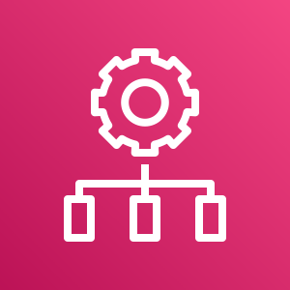
OI Domains – Core Operations Functions: Provisioning & Configuration Management
Tools, Templates and Best Practices
Synopsis Provisioning procedures help plan, implement and maintain a stable technical infrastructure to support the organization’s business processes. The goal of Configuration Management is to define and control the cloud service components, and maintain accurate configuration records.
AWS Config
AWS Service Catalog
AWS CloudFormation
AWS Systems Manager
AWS License Manager
Why is the OI Function Important?
Appropriate use of resources
Controlling spend
Self Service provisioning
Enable organization to transition to a mindset of “Infrastructure as code”
AWS OpsWorks
EC2 Image Builder
Establish Infrastructure Templates (Infrastructure as Code)
Establish a process for template lifecycle management
Use a Service Catalog
Move to a software based configuration management from hardware based configuration management
Understand how to integrate flexible license management with configuration management tools, AWS Config, and automation
AMI Lifecycle Management

Slide 34
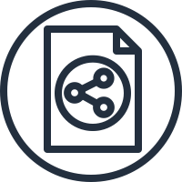
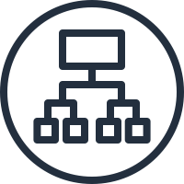

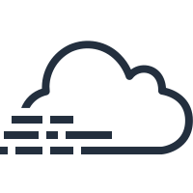
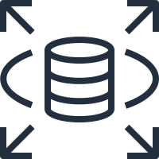
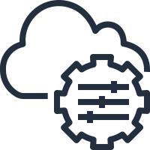



Cloud Native Configuration Management
Govern Configuration Management through AWS Config for AWS Services
Amazon VPC
Amazon EC2
Amazon S3
Classic Load Balancers
Application Load Balancers
Amazon EBS volumes
AWS CloudTrail
AWS IAM
Amazon Redshift
Amazon RDS
AWS Systems Manager
AWS Certificate Manager
Amazon CloudWatch alarms
AWS CloudFormation stacks
Amazon DynamoDB tables
AWS Auto Scaling groups
AWS CodeBuild
AWS CodePipeline
AWS WAF
Amazon CloudFront
AWS Elastic Beanstalk
AWS Lambda
AWS X-Ray
AWS Shield

Slide 35
Provisioning & Configuration Management – Key Epics
Govern everything as code
Infrastructure as a Code, Configuration as a Code, Application Code
Adopt a change configuration management tool (Jenkins, AWS Systems Manager)
Govern change using code versioning tool (Github, Codecommit, Bitbucket)
Standardize Provisioning through a Service Catalog
Define and automate approved Platform Patterns
Expose standard patterns through the service catalog (Bastion Host, serverless microservices, etc.)
Automate Patching techniques
Automate Patching using Systems Manager
Define patching techniques per solution (Blue-Green / Traditional)
Automate Golden AMI maintenance
Streamline AMI Maintenance and Patching using Systems Manager
Reinforce policy for instances created from approved AMIs using AWS config

Slide 36
AWS Operational Domains
Core Operations Functions
Security & Control Functions
Business Management Functions
Supporting Functions
Platform Architecture & Governance
IT Change Management
Financial Management
Reporting & Analytics
Operational Health
Resource Inventory Management
Capacity Planning & Forecasting
Continuous Improvement
Provisioning & Configuration Management
Identity & Access Management
Organizational Change Management
Application Lifecycle Management
Availability & Continuity Management
Security Management
Vendor Management

Slide 37


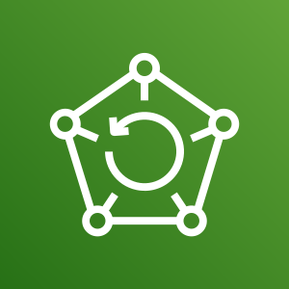



OI Domains – Core Operations Functions: Availability & Continuity Management
Tools, Templates and Best Practices
Synopsis Identify repeatable patterns to support business continuity needs based upon customer needs
AWS Auto Scaling
AWS
Well-Architected
Tool
AWS Backup
Elastic Load Balancing
AWS Storage Gateway
AWS Glacier
Review current requirements
Define criteria for SLA measurement
Determine and document both the recovery point and recovery time objectives for each application.
Define implementation and operational patterns for HA and DR
Use of AZ’s Regions, Hot/Pilot Standbys, etc.
Explore native AWS Services to assist implementation and operations
Perform Well Architected Assessment
Determine long-term multi-region deployment strategy per application
Resiliency testing
Why is the OI Function Important?
Ensuring the resiliency of services
Having proactive plans to recover and support services in the event of a declared disaster

Slide 38
Availability & Continuity Management – Key Epics
Design for Failure – Well Architected Solutions
Design for Failure and use Well-Architected Framework
Define Architecture Patterns for required SLAs according to BIA
Use the right Backup Tool for the right needs
Understand Backup vs HA vs DR and choose the Right Tools for each one
Implement a contingency connection (VPN o DX) to selected DR region
Choose and implement the right Hybrid Storage Cloud Backup Solution
Disaster Recovery Strategy & Capabilities
Design a DR Solution to meet required RPOs and RTOs for Pilot Migration Apps
Build DR runbooks
Adapt Ops mindset from Fire-Fighting to Fire-Injecting
Understand the mindset behind resiliency engineering (Availability Obsession)
Run game days to test: HA, DR, Backups and eventually use Chaos Engineering
Notes:
Sustain / Traditional
Development Teams develop, build, and package software for release by operations
Cloud Engineering may or may not be present to codify infrastructure standards and artifacts for release by operations
Operations May leverage either CCOE products and services to deploy and manage applications and infrastructure in production
Operations may be a 3rd party MSP, or an existing on-prem operations team.
Optimize / CloudOps
Development Teams develop, build, and package software for release by operations
Cloud Engineering codifies infrastructure standards and artifacts; provides enabling services for operations and security.
Cloud Operations: provisions and configures infrastructure from standard CCOE products and services; leverages CCOE products and services to manage applications and infrastructure in production
Grow / DevOps
Development Teams leverage CCOE products and services to:
Develop, build, and package software for release
Provision and configure infrastructure from standard CCOE products and services
Leverages CCOE products and services to deploy and manage applications and infrastructure in production
Cloud Engineering codifies infrastructure standards and artifacts; provides enabling services for operations and security.

Slide 39
AWS Operational Domains
Core Operations Functions
Security & Control Functions
Business Management Functions
Supporting Functions
Platform Architecture & Governance
IT Change Management
Financial Management
Reporting & Analytics
Operational Health
Resource Inventory Management
Capacity Planning & Forecasting
Continuous Improvement
Provisioning & Configuration Management
Identity & Access Management
Organizational Change Management
Application Lifecycle Management
Availability & Continuity Management
Security Management
Vendor Management

Slide 40

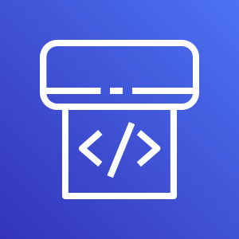
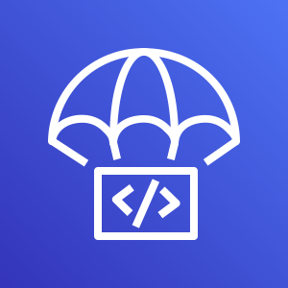
OI Domains – Security & Control Functions: Change Management
Synopsis IT Change Management from an ITIL perspective balances the need for organizations to introduce and modify IT services while minimizing the risk to Production Ready environments. Change Management also focuses on the automated control of change in your cloud environment through policies and thresholds with visibility across services. In high-velocity organizations, it is a common practice to decentralize change approval, making the peer review a top predictor of high performance.
Tools, Templates and Best Practices
AWS Systems Manager
AWS Config
Rules
AWS AppConfig
AWS CodePipeline
Why is the OI Function Important?
Appropriate use of resources
Managing risk and impact to cloud services
If you don’t change environment then you lose the agility benefits of the cloud.
AWS CodeDeploy
Audit & Standards / Compliance
ITSM Process integrations with Incident, Event and Configuration Management
Version Control & Release Management
Change Schedule & Deployment Management
3rd Party Change Management Applications
3rd Party Application Integrations (where applicable)

Slide 41
Change Management – Key Epics
Integrate Cloud Changes with existing Change Processes
Enable existing change board on the recommended changes in the cloud
Best Practices Incorporating IaC artifacts in to Change Management
Define Change Matrix for each type of change: Normal, Standard, Emergency, Post Facto, Unauthorized
Automation of Standard Changes using AWS Systems Manager
CI / CD Pipelines into Change Management
Automate Process Integration with existing ITSM Tools
Automate RFC creation in ITSM Tools for Standard Changes
Automate RFC manual approval on Major Changes as possible

Slide 42
AWS Operational Domains
Core Operations Functions
Security & Control Functions
Business Management Functions
Supporting Functions
Platform Architecture & Governance
IT Change Management
Financial Management
Reporting & Analytics
Operational Health
Resource Inventory Management
Capacity Planning & Forecasting
Continuous Improvement
Provisioning & Configuration Management
Identity & Access Management
Organizational Change Management
Application Lifecycle Management
Availability & Continuity Management
Security Management
Vendor Management

Slide 43


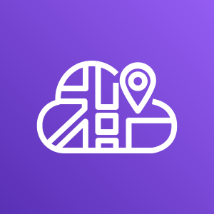
OI Domains – Security & Control Functions: Resource Inventory Management
Tools, Templates and Best Practices
Synopsis Resource Inventory Management provides the ability to define and control the components of services and infrastructure, and maintain accurate configuration records.
AWS Config
AWS CloudTrail
AWS License Manager
AWS Trusted Advisor
AWS Systems Manager
Why is the OI Function Important?
AWS Application Discovery Service
AWS Cloud Map
Compliance with corporate governance
Audit support
Visibility into service assets
Cost optimization
Effective change and release management
Faster incident and problem resolution
3rd Party CMDB
Discover and maintain the relationships of changing cloud resources
Manage cloud assets against resource limits
Manage software inventory and incremental updates
Manage license inventory and usage
Enable integration with 3rd Party ITSM applications such as Change Management, Event and Incident Management
AWS Application Discovery Service
AWS Cloud Map

Slide 44
Resource & Inventory Management – Key Epics
Automate Inventory Discovery and Tracking
Review capabilities to Automate CIs and Software Inventory Management
Adopt tools and procedures to Automate Discovery and Dependency Management
Automate License Management
Review Cloud License Management capabilities for BYOL resources on the Cloud
Define tools and procedures for Cloud License Management.
Automate CMDB Discovery and Integrate with existing ITSM
Track Cloud Ephemeral resources (Autoscaling, serverless, etc.)
Automate CMDB Update on configuration change

Slide 45
AWS Operational Domains
Core Operations Functions
Security & Control Functions
Business Management Functions
Supporting Functions
Platform Architecture & Governance
IT Change Management
Financial Management
Reporting & Analytics
Operational Health
Resource Inventory Management
Capacity Planning & Forecasting
Continuous Improvement
Provisioning & Configuration Management
Identity & Access Management
Organizational Change Management
Application Lifecycle Management
Availability & Continuity Management
Security Management
Vendor Management

Slide 46
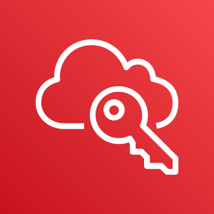
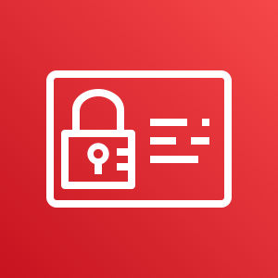

OI Domains – Security & Control Functions: Identity & Access Management
Synopsis Securely control access to cloud services and resources for your users. (Role based access, NACL, Security Groups)
Defined access and entry points to your cloud environment. (Network, VPC, Access to console, Access to services, Remote Access, Env Access)
Tools, Templates and Best Practices
AWS Single Sign-On
AWS Identity and Access Management
AWS Directory Service
AWS CloudTrail
Why is the OI Function Important?
Compliance, least privilege
Minimize business risk
Ensure secure access
AWS IAM Best Practices
Grant Least Privilege
Corp Active Directory/ Federation Integration
Single Directory for Cloud
Centrally Manage Access
Audit access and trace actions

Slide 47
Identity & Access Management – Key Epics
Integrate Corp Identity Repo with AWS using SSO
Sync IAM roles with existing corporate Group/Roles and existing HR workflows
Integrate Cloud Access through a SSO using existing corporate identities
Enable MFA access for both Console and CLI
Enable MFA or upgrade to a third-party SSO as a Service (OpenId, SAML)
Grant Least Privilege for Roles
Maintain roles baseline granting least privilege
Manage Tags for Access Controls
Define Access Control Tags Lifecycle Management

Slide 48
AWS Operational Domains
Core Operations Functions
Security & Control Functions
Business Management Functions
Supporting Functions
Platform Architecture & Governance
IT Change Management
Financial Management
Reporting & Analytics
Operational Health
Resource Inventory Management
Capacity Planning & Forecasting
Continuous Improvement
Provisioning & Configuration Management
Identity & Access Management
Organizational Change Management
Application Lifecycle Management
Availability & Continuity Management
Security Management
Vendor Management

Slide 49

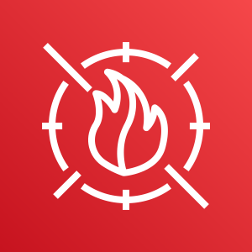
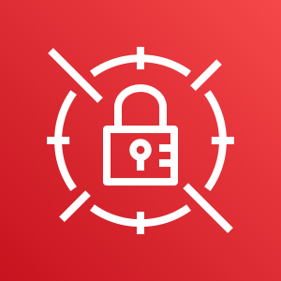


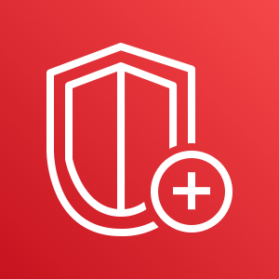

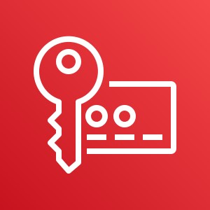

OI Domains – Security & Control Functions: Security Management
Tools, Templates and Best Practices
Detect
Infra Sec
Data Protect
Synopsis Protecting information, systems, and assets while delivering business value through risk assessments and mitigation strategies.
AWS Config
AWS Cloudtrail
AWS Inspector
AWS Secrets Manager
AWS Cert Manager
AWS WAF
AWS GuardDuty
AWS Cloudwatch
AWS Shield
AWS Macie
AWS Key Management Service
Why is the OI Function Important?
Data/Fraud Protection and Prevention
Ensure adherence to security compliance controls
AWS Security Hub
Identify procedures for customers role in the AWS Shared Responsibility Model for Security
Enable both Incident Management and Security Incident Management processes and tooling
Enable organization to adopt DevSecOps model
AWS Well-Architected Framework
AWS Security Whitepaper
Audit & Standards / Compliance
3rd Party Security Tools

Slide 50
Security Management – Key Epics
Design & Implement Detective Controls
Integrate Log Cloud Events with existing SIEM capabilities
Define & Implement Centralized Logging Configurations
Design & Implement Infrastructure Security
Review & Design VDS Infrastructure Security Monitoring Tools
Integrate with existing security monitoring process
Design & Implement Data Protection
Build Data Protection detective / responsive controls
Define an incident response Framework
Define & Implement automated investigative tools
Adopt continuous detection
Implement iteratively automated response actions

Slide 51
AWS Operational Domains
Core Operations Functions
Security & Control Functions
Business Management Functions
Supporting Functions
Platform Architecture & Governance
IT Change Management
Financial Management
Reporting & Analytics
Operational Health
Resource Inventory Management
Capacity Planning & Forecasting
Continuous Improvement
Provisioning & Configuration Management
Identity & Access Management
Organizational Change Management
Application Lifecycle Management
Availability & Continuity Management
Security Management
Vendor Management

Slide 52

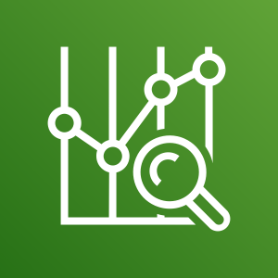

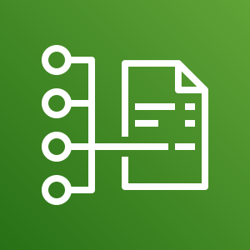
OI Domains – Business Management Functions: Financial Management
Tools, Templates and Best Practices
Synopsis Optimize the cost of cloud services while balancing the quality and risk of providing those services.
AWS Trusted Advisor
AWS Compute Optimizer
AWS Budgets
AWS Cost Explorer
Why is the OI Function Important?
Controlling spend
Giving visibility into the cost of a business service so customers can have data points to access in a decision process
Enables the ”freedom” to innovate if cost inhibitors are removed
Reserved Instance
Reporting
AWS Cost and
Usage Report
Leverage AWS Consolidated Billing
Tagging and Taxonomy Standards: Resource, Chargeback/Billing
Establish cost control standards/guidelines across business units to avoid unexpected charges Establish selection criteria based on strategic objectives of the business and technical capability
3rd Party Financial Management Tools

Slide 53
Financial Management – Key Epics
Implement Automated Chargeback / Showback Processes
Define Tagging best practices to automate Chargeback / Showback
Reinforce Financial Tagging Rules
Design & Implement Showback to Business Units
Implement Automated Budgets and spending Policies
Define Standard Spending Policies
Reinforce account spent policies using Automated Budgets on AWS

Slide 54
AWS Operational Domains
Core Operations Functions
Security & Control Functions
Business Management Functions
Supporting Functions
Platform Architecture & Governance
IT Change Management
Financial Management
Reporting & Analytics
Operational Health
Resource Inventory Management
Capacity Planning & Forecasting
Continuous Improvement
Provisioning & Configuration Management
Identity & Access Management
Organizational Change Management
Application Lifecycle Management
Availability & Continuity Management
Security Management
Vendor Management

Slide 55
OI Domains – Business Management Functions: Capacity Planning & Forecasting
Tools, Templates and Best Practices
Synopsis Ensure the cloud is able to scale to meet business demand, including people and processes and tools.
Amazon CloudWatch
AWS Auto Scaling
AWS CloudTrail
AWS Budgets
AWS Trusted Advisor
Why is the OI Function Important?
Ensures service performance and availability
Balancing spending with demand
If you don’t change environment then you lose the agility benefits of the cloud.
AWS Cost Explorer
AWS Well Architected
Identify thresholds to expand capacity via auto scaling where appropriate
AWS Well-Architected Framework
Forward-looking analytics of capacity requirements, potential of hitting service limits,
On-premise tooling limits, CIDR block limits etc.
May include indicative future costs and the cost implications of a change

Slide 56
Capacity Planning & Forecasting – Key Epics
Monitor and Anticipate AWS Service Limits
Understands AWS Trusted Advisor and Services Limits
Leverage the AWS Cloud Resource Reservations
Apply AWS Best practices for Resource Reservations in a Multi-Account Environment
Leverage the AWS Elasticity & Scalability Capabilities
Automate Elasticity and Scalability for handing capacity (AWS Instance Scheduler)
Understand and Apply Auto-Scaling options and techniques for capacity
Storage and Compute Cloud Scalability Runbooks
Procedures to scale storage and compute resources on the AWS Cloud

Slide 57
AWS Operational Domains
Core Operations Functions
Security & Control Functions
Business Management Functions
Supporting Functions
Platform Architecture & Governance
IT Change Management
Financial Management
Reporting & Analytics
Operational Health
Resource Inventory Management
Capacity Planning & Forecasting
Continuous Improvement
Provisioning & Configuration Management
Identity & Access Management
Organizational Change Management
Application Lifecycle Management
Availability & Continuity Management
Security Management
Vendor Management

Slide 58
OI Domains – Business Management Functions: Organizational Change Management
Synopsis
Design the team(s) responsible for mobilizing critical cloud resources.
Define how an organization builds and executes their cloud strategy (teams designed for how the customer intends to operate in future state)
Tools, Templates and Best Practices
Executive Sponsorship (includes support, influence and enforcement)
Cloud Champions (throughout organizations)
AWS Training and Certification Programs
Training and Communication Programs (including Plans)
Establish Incentive Programs and reward/promote success
Identify lighthouse cloud workloads to move to production to make the change “real”
Understand change will be iterative
Why is the OI Function Important?
Promotes cloud adoption within an organization
Minimizes the resistance to change
Enables people to learn new skills and become a part of the new cloud ecosystem within an organization
Notes:
Note: Customers should develop incentive based programs within their organizations to enhance cloud adoption.

Slide 59
AWS Operational Domains
Core Operations Functions
Security & Control Functions
Business Management Functions
Supporting Functions
Platform Architecture & Governance
IT Change Management
Financial Management
Reporting & Analytics
Operational Health
Resource Inventory Management
Capacity Planning & Forecasting
Continuous Improvement
Provisioning & Configuration Management
Identity & Access Management
Organizational Change Management
Application Lifecycle Management
Availability & Continuity Management
Security Management
Vendor Management

Slide 60
OI Domains – Business Management Functions: Vendor Management
Synopsis Guidance and standards for the procurement of services and products that will either integrate and/or be consumed by vendors on the AWS platform.
Tools, Templates and Best Practices
Establish a Tagging strategy for resources within the AWS platform that are associated to vendor services
Establish process to order products and services that will integrate with the AWS platform
Establish selection criteria based on strategic objectives of the business and technical capability
Establish Vendor SLAs for services
Establish Performance reviews of services to ensure continual improvement
3rd Party Procurement Tools
3rd Party Vendor Management Tools
Why is the OI Function Important?
Ensure the SLA and performance objectives with vendors are being met
Visibility into the spend and the ability to use the data to make informed decisions
Establish performance benchmarks for future vendors to follow as customers mature on the AWS platform

Slide 61
AWS Operational Domains
Core Operations Functions
Security & Control Functions
Business Management Functions
Supporting Functions
Platform Architecture & Governance
IT Change Management
Financial Management
Reporting & Analytics
Operational Health
Resource Inventory Management
Capacity Planning & Forecasting
Continuous Improvement
Provisioning & Configuration Management
Identity & Access Management
Organizational Change Management
Application Lifecycle Management
Availability & Continuity Management
Security Management
Vendor Management

Slide 62


OI Domains – Support Functions: Reporting & Analytics
Synopsis The measurement, analysis, & communication of observations to help improve operational activities.
Tools, Templates and Best Practices
Amazon CloudWatch
AWS Cost Explorer
Amazon Elasticsearch Service
AWS CloudTrail
Why is the OI Function Important?
Determine what levels of service are providing,
Determine where the issues are within the platform and develop corrective actions
Determine when service levels are breached
Control spend
Amazon Athena
AWS Trusted Advisor
AWS QuickSight
Establish KPIs (based on strategic objectives)
Determine Cost Controls/Spending Thresholds
3rd Party Analytics/Dashboard Tools (i.e. Splunk, Tableau)

Slide 63
Reporting & Analytics – Key Epics
Identify Operational Excellence Metrics and KPIs
Draft the first KPIs for Operational Excellence
Implement the Operational Dashboard
Select an Analytics/Dashboard Tool (Splunk, Tableau, AWS Insights, etc.)
Build Data Crawl landscape for data ingest
Build Dashboards and define RBAC to info

Slide 64
AWS Operational Domains
Core Operations Functions
Security & Control Functions
Business Management Functions
Supporting Functions
Platform Architecture & Governance
IT Change Management
Financial Management
Reporting & Analytics
Operational Health
Resource Inventory Management
Capacity Planning & Forecasting
Continuous Improvement
Provisioning & Configuration Management
Identity & Access Management
Organizational Change Management
Application Lifecycle Management
Availability & Continuity Management
Security Management
Vendor Management

Slide 65
OI Domains – Support Functions: Continuous Improvement
Synopsis A program of iterative change designed to improve the user experience, performance, and capabilities of the services built on the platform.
.
Tools, Templates and Best Practices
Establish a CSI Register for major features (roadmap)
Create release management schedule
Prioritize changes/enhancements based on strategic business objectives
Iterating on each of your core functions to deliver measurable improvements.
Why is the OI Function Important?
Improves services and user experience
Improves perception of cloud adoption
Increases customer satisfaction
Improves skills of technical resources

Slide 66
AWS Operational Domains
Core Operations Functions
Security & Control Functions
Business Management Functions
Supporting Functions
Platform Architecture & Governance
IT Change Management
Financial Management
Reporting & Analytics
Operational Health
Resource Inventory Management
Capacity Planning & Forecasting
Continuous Improvement
Provisioning & Configuration Management
Identity & Access Management
Organizational Change Management
Application Lifecycle Management
Availability & Continuity Management
Security Management
Vendor Management

Slide 67
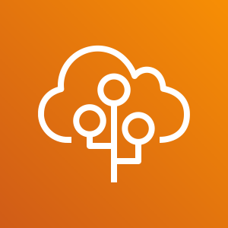

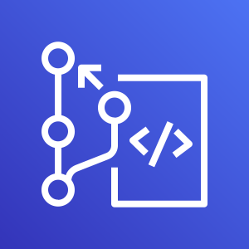
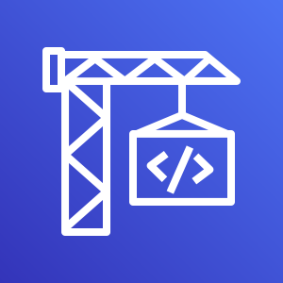
OI Domains – Support Functions: Application Lifecycle Management
Synopsis Focus is on understanding the impact and value a service has throughout its lifecycle.
Tools, Templates and Best Practices
AWS CloudFormation
AWS Elastic Beanstalk
AWS OpsWorks
AWS CodeStar
Why is the OI Function Important?
Consistent deployment of application services
Ensures all stakeholders understand the changes during the development phases
Integrates application and infrastructure components into one product
Appropriate use of resources
AWS CodeCommit
AWS CodeDeploy
AWS CodePipeline
AWS CodeBuild
AWS Overview of Deployment Options
3rd Party Project Management/SCRUM Tools
3rd Party Testing and Developer Tools
CI / CD, Release Planning, Application Deployment Techniques / Runbooks
ITSM Processes (Release, Change, Incident, Event Management)

Slide 68
Application Lifecycle Management – Key Epics
Improve efficiency through Release Management Automation
Adopt Deployment Techniques (CI/CD, Blue/Green, etc.)
Improve Code Quality and Security Scanning
Optimize compute resource using Batch Processing
Batch Processing Techniques and Best Practices
Automate Database Administration
Adopt DataOps Tools and Techniques

